Slide 1
MGI Solution Explorer in your CI Workflow
Derek Trepanier
Senior Software Engineer

Slide 2
The Basics
Installation
Building Projects
Additional Solution Items
Version Numbers
Build Configurations

Slide 3
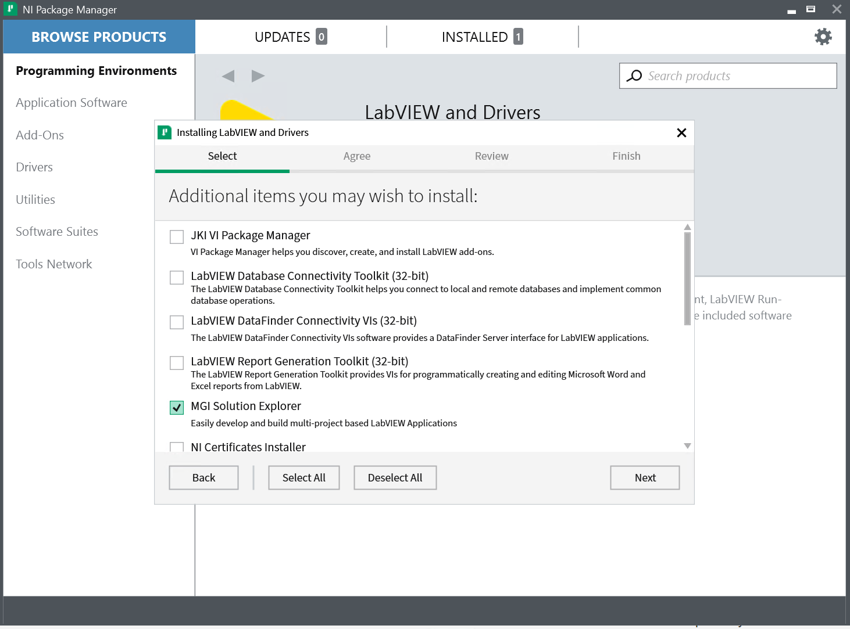
Installation
Automatically install when installing LabVIEW!
Standalone install from MGI
Installer | NIPM Feed*
Latest Release | https://sln-exp-dist.s3-us-west-1.amazonaws.com/master/
Latest Beta | https://sln-exp-dist.s3-us-west-1.amazonaws.com/develop/
* How to Register an NIPM Feed

Slide 4
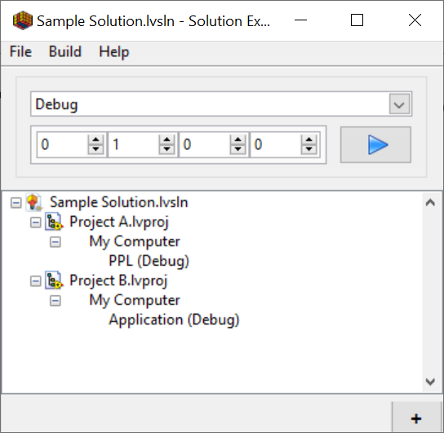
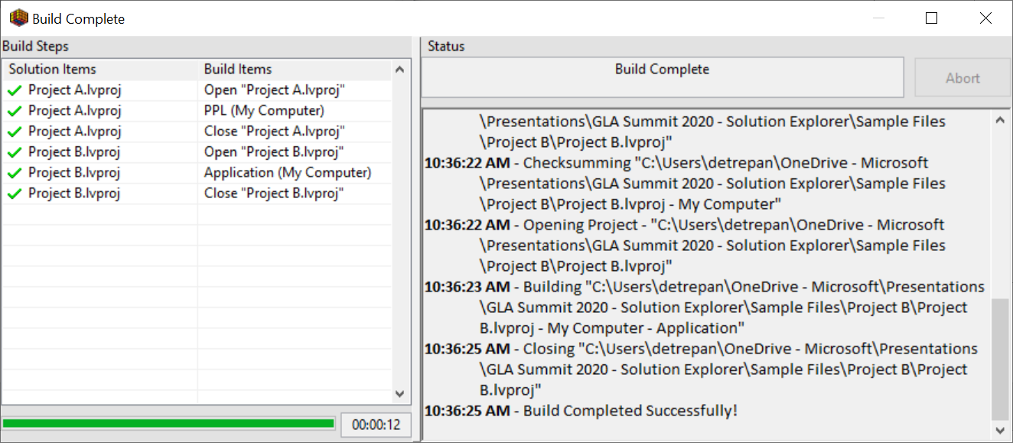
Building Projects
A simple window to group projects and quickly access
A single button to build multiple projects
Demo

Slide 5
Solution Items
Solutions are just a list of items
A build just goes down the list and executes a build on each item
Solution Explorer implements a plugin architecture to allow a variety of items in a solution
You can implement custom solution items if needed
Default Solution Items:
LabVIEW Projects – Build LV Items
Package Feed – Add a package to an NI Feed
Run VI – Execute a VI
Self Extracting Zip – Create an SFX file (useful for installer distribution)
Shell Command – Run a command in the command prompt
Solution – Run the build command for another solution

Slide 6
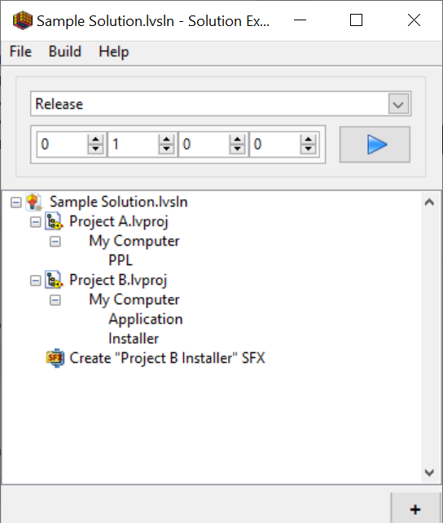
Version Numbering
Version numbers are saved in the solution file
All items build are given the same version number

Slide 7
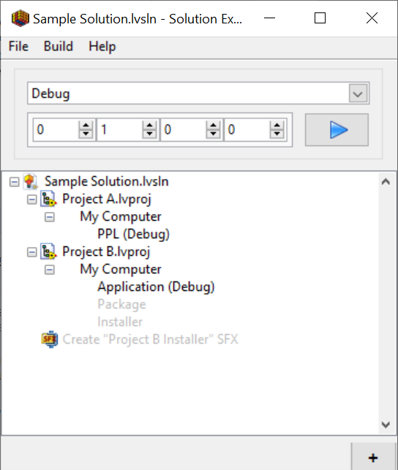
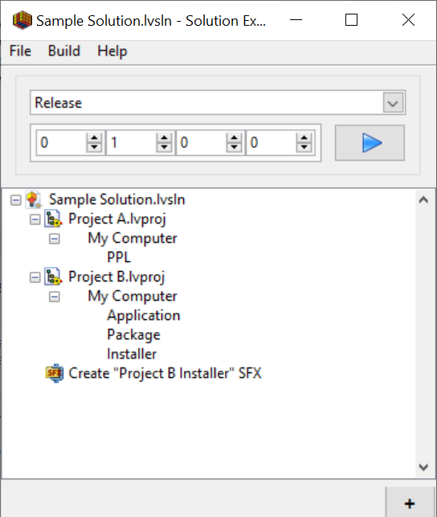
Build Configurations
A solution has multiple build configurations
Build configurations are used to saved quick tweaks of the solution’s settings to:
Enable/disable items
Change debug flag
Etc
Solution can have any number of configurations

Slide 8
The CLI
Basic Build
Version number

Slide 9
Basic Build
Solution Explorer builds can be launched using the command
Solution progress will be written to the console
Add the Solution explorer exe to your system path variable for more convenient calling
“<install path>\MGI Solution Explorer.exe” CLI build “<sln path>” “<build config>”
“MGI Solution Explorer.exe” CLI build “Test Solution.lvsln” Release

Slide 10
Version Numbering
It’s helpful in the CI use case to set the version number of the build
Use the argument following argument in your command to specify the version
Use “x” to use the version numbers saved in the file
Ex: –version 1.2.3.x will build with version 1.2.3, but the build number will be whatever is saved in the solution file (set using the Solution Explorer UI)
–version <major>.<minor>.<patch>.<build>
“MGI Solution Explorer.exe” CLI build “Test Solution.lvsln” Release –version 1.2.3.x

Slide 11
Continuous Integration with Solution Explorer
Solution Setup
Build Agent Setup
The build script

Slide 12
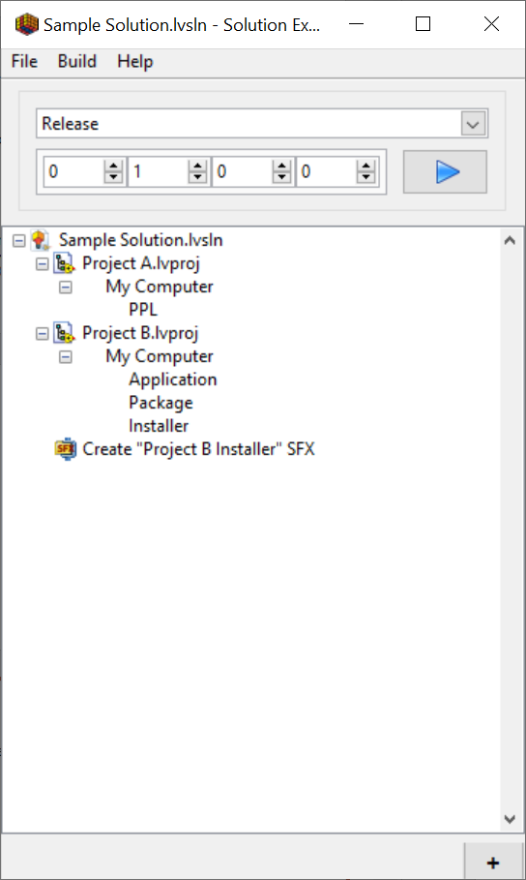
Solution Setup
Boom. Already done.
Just manage your solution like normal
Test builds on your dev PC like normal
Future changes (adding projects, change settings, etc) can be made using the Solution Explorer GUI

Slide 13
Build Agent Setup
Install LabVIEW
Install Solution Explorer
Install any other tools you may need
mgislnexp.bat
Some build environments have trouble with the space in the exe, use this bat script to help (add this BAT to your PATH variable)
@echo off
"%~dp0..\MGI Solution Explorer.exe" CLI %*

Slide 14
Sample Build Script (Github Actions)
name: Demo Build
on: push
# A workflow run is made up of one or more jobs that can run sequentially or in parallel
jobs:
build:
runs-on: self-hosted
steps:
# Checks-out your repository under $GITHUB_WORKSPACE, so your job can access it
- uses: actions/checkout@v2
# Perform the build (using the GITHUB_RUN_NUMBER as the build number)
- name: Build MGI Solution Explorer Solution
run: mgislnexp build "Sample Files\Sample Solution.lvsln" Release -version x.x.x.$env:GITHUB_RUN_NUMBER
# Store Build Items
- name: Archive artifacts
uses: actions/upload-artifact@v2
with:
name: Build Items
path: |
Sample Files\builds

Slide 15
Links
MGI Solution Explorer
https://www.mooregoodideas.com/products/solution-explorer/index.html
https://gitlab.com/mgi/Solution-Explorer
This Presentation
https://github.com/detrepan3/presentation-gla-summit-2020-slnexp-demo

